Slide 1
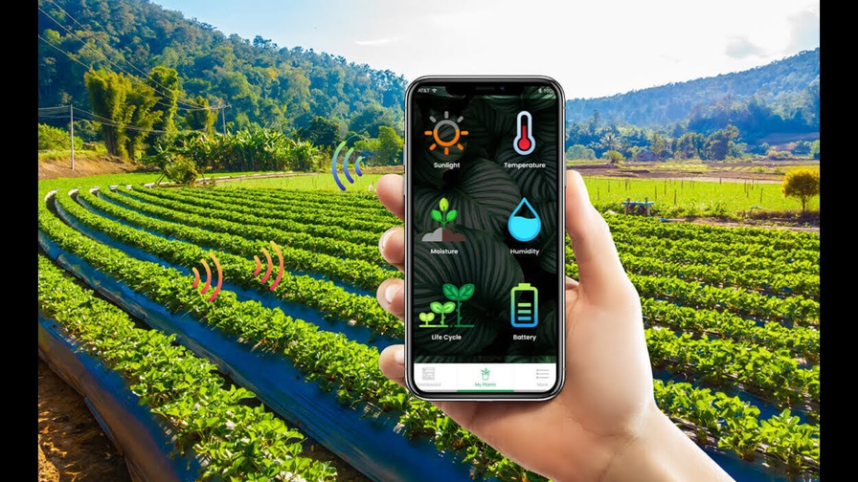
SMART IRRIGATION
SYSTEM
CSE-3 SEM VI
160121733164 Meghanath
160121733165 Sai Vishnu
160121733166 Vivek
160121733167 Sharath
160121733168 Lokesh
160121733169 Santosh

Slide 2
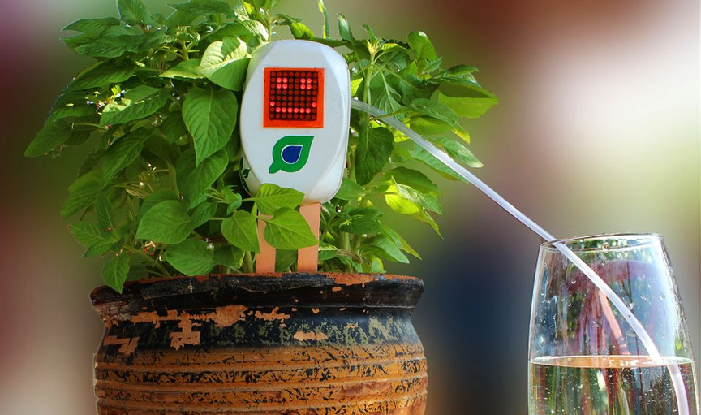
Content
01
Problem Statement
02
Our Solution
03
Method & Setup
04
Working
05
Our clients
06
Future Scope

Slide 3
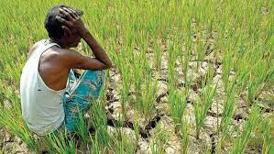
What we
intend to
solve?
Smart irrigation systems have been developed to cater to the specific water requirements of different plants, ensuring optimal efficiency, yield, and growth.
These systems account for the varying water needs and conditions necessary for the growth of different plant species. Their purpose is to mitigate the risks associated with both under-watering and over-watering.

Slide 4
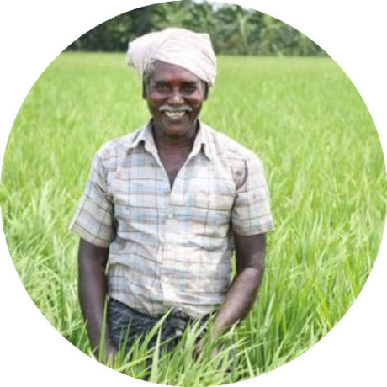
Our Solution
To achieve desired yields and results, we consider multiple inputs, including the soil's moisture level, prevailing climatic conditions such as temperature and humidity, and the amount of light reaching the plant.
In addition to these factors, we maintain continuous monitoring of soil moisture content and soil pH, while also keeping a vigilant eye on any climate fluctuations.
This comprehensive approach allows us to tailor our watering practices precisely to the specific needs of the plant.

Slide 5
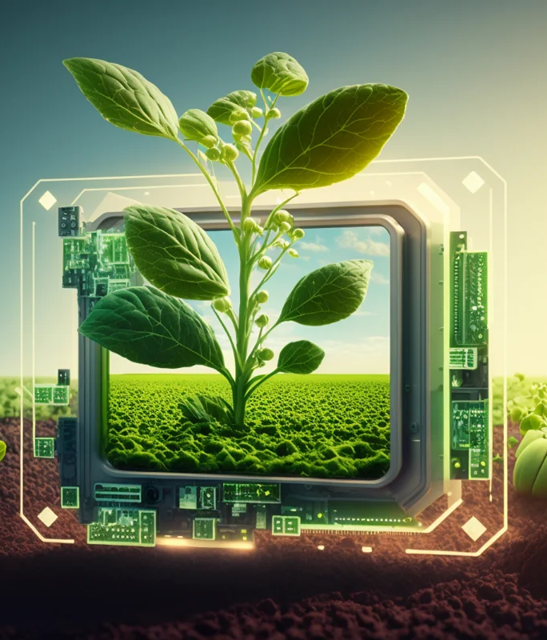
If users are dissatisfied with the suggested watering regimen, they will have the flexibility to customize the watering needs of their chosen plant.
Recognizing that various plants have unique requirements, we plan to establish a database containing information about different plant species and their specific watering needs.
Users will have access to an interface where they can select their desired plant, allowing the system to autonomously manage the plant's watering requirements without inconveniencing the user.

Slide 6
PROGRESS TILL DATE
Research
Market
Competitors
Survey Conduction
Case Studies
Website
Prototype building

Slide 7


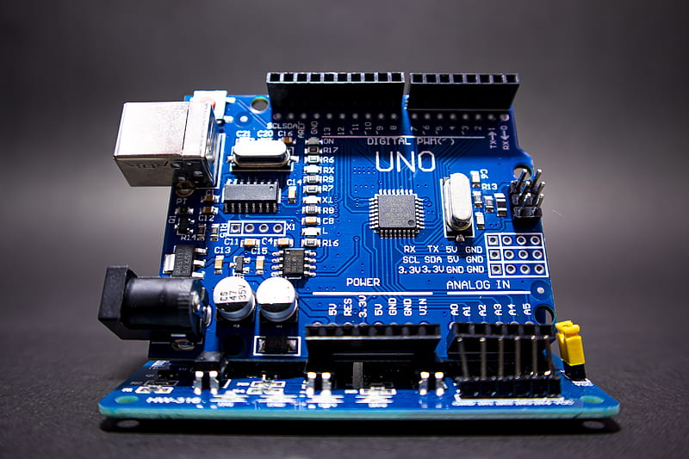
ARDUINO
To accomplish this task, we employ the Arduino software in conjunction with an Arduino board. By establishing a connection between the board and our computer, we can effectively
program various sensors and equipment essential for the functionality of our smart irrigation system. These components are configured and programmed using the Arduino Uno software.

Slide 8
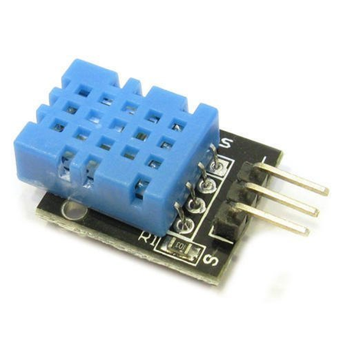
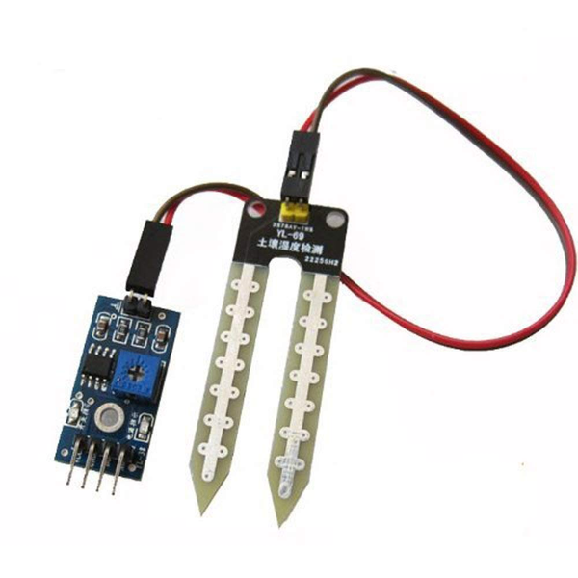
Working
DHT11 Temperature Sensor
The DHT11 is a low-cost temperature and humidity sensor that is commonly used for measuring temperature and humidity in various DIY electronics projects. It is a digital sensor, which means it communicates temperature and humidity data in a digital format that can be easily read by a microcontroller like Arduino or Raspberry Pi.
Soil Moisture Sensor
A soil moisture sensor is a device used to measure the moisture content of soil. It's a valuable tool in agriculture and gardening for monitoring soil conditions and ensuring that plants receive the appropriate amount of water.

Slide 9
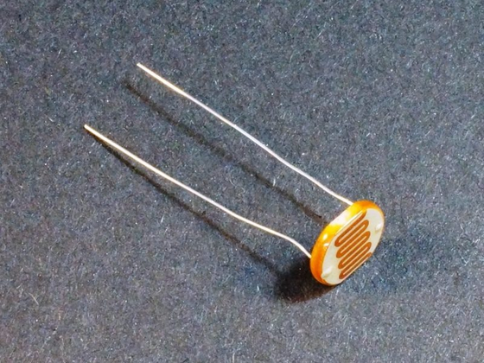
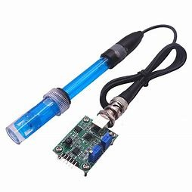
Working
Light Sensor
Light sensors detect the intensity of light in their environment.
LDRs are commonly used and their resistance changes with light levels.
Applications include automatic lighting systems, dusk-to-dawn switches, or ambient light sensing in devices like smartphones.
pH Sensor
pH sensors are used to measure the acidity or alkalinity (pH level) of a liquid.
They are essential in fields like chemistry, agriculture (for soil pH measurement), and water quality monitoring.
pH sensors often require calibration and can be interfaced with microcontrollers for data logging or control systems.

Slide 10
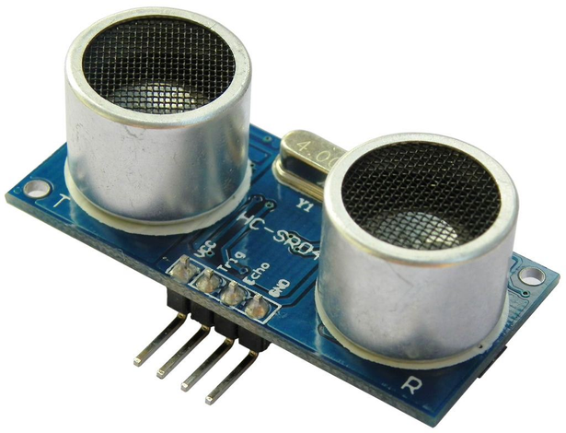
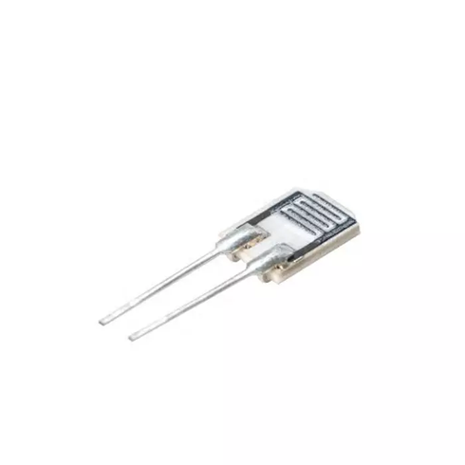
Working
Ultrasonic Sensor
- Ultrasonic sensors use sound waves to measure distance to an object.
- They emit ultrasonic pulses and measure the time it takes for the sound waves to bounce back.
- Common applications include obstacle detection, distance measurement, and even water level measurement in tanks or wells.
Humidity Sensor
- These sensors measure the moisture content or relative humidity in the air.
- They can provide data on the humidity level, which is valuable for applications like weather stations, climate control, or plant growth monitoring.
- You can interface humidity sensors with microcontrollers like Arduino or Raspberry Pi to read and process humidity data.

Slide 11
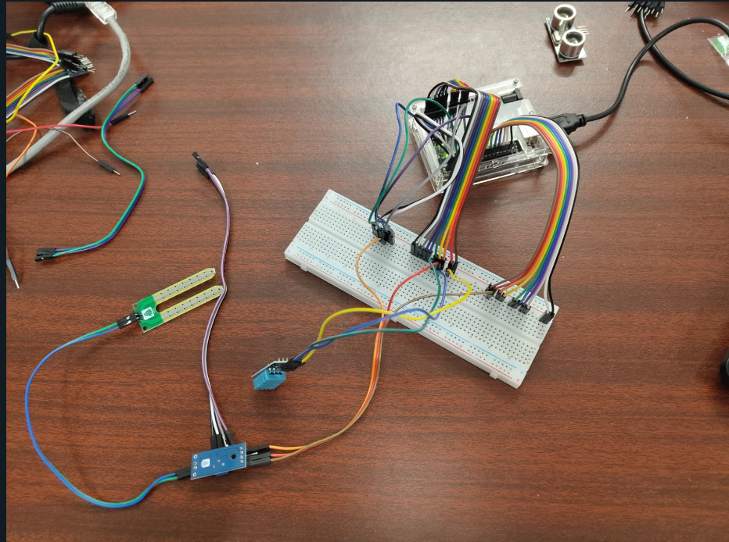
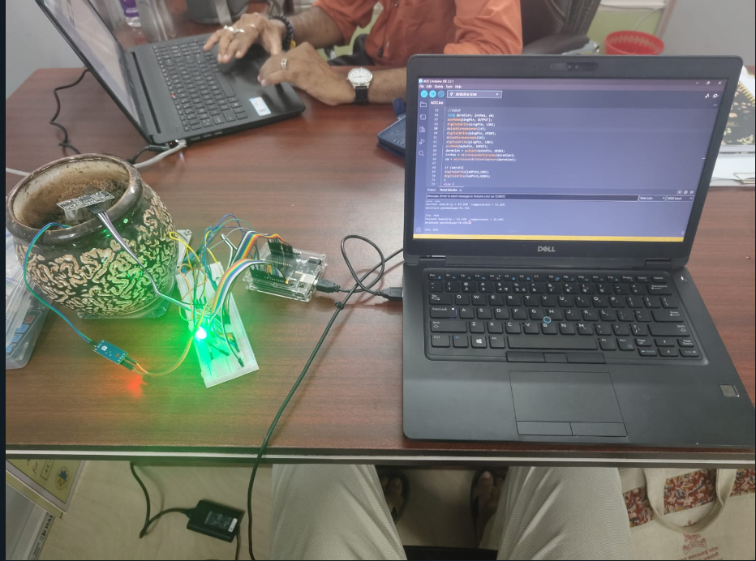
Prototype

Slide 12


Research- Market
With a predicted value of $1.44 billion in 2020 and a compound annual growth rate (CAGR) of 13.9% from 2021 to 2030, the worldwide smart irrigation market is expected to reach $5.57 billion by 2030
The installation cost of these systems is high and is feasible for large farms in developed countries such as the US, Canada, Sweden, and the Netherlands. Most agricultural farms in developing countries are small. For instance, 85% of the agricultural households in India own less than 2 hectares of land. The implementation of smart irrigation market technologies is
not feasible in such farms owing to the high costs and low return on investment.

Slide 13
Research- Competition
NETAFIM
In terms of drip irrigation technology and intelligent irrigation systems, Netafim is a
world leader. Since its founding in Israel in 1965, the company has grown to become
one of the leading names in precision agriculture. Sustainable agricultural methods
and water efficiency have benefited greatly from Netafim's technologies
Rain Bird Corporation
Rain Bird Corporation is a well-known company that specializes in irrigation products and
services. Founded in 1933, Rain Bird has grown to become a global leader in the irrigation
industry, offering a wide range of products for residential, commercial, agricultural, and golf
course applications.

Slide 14
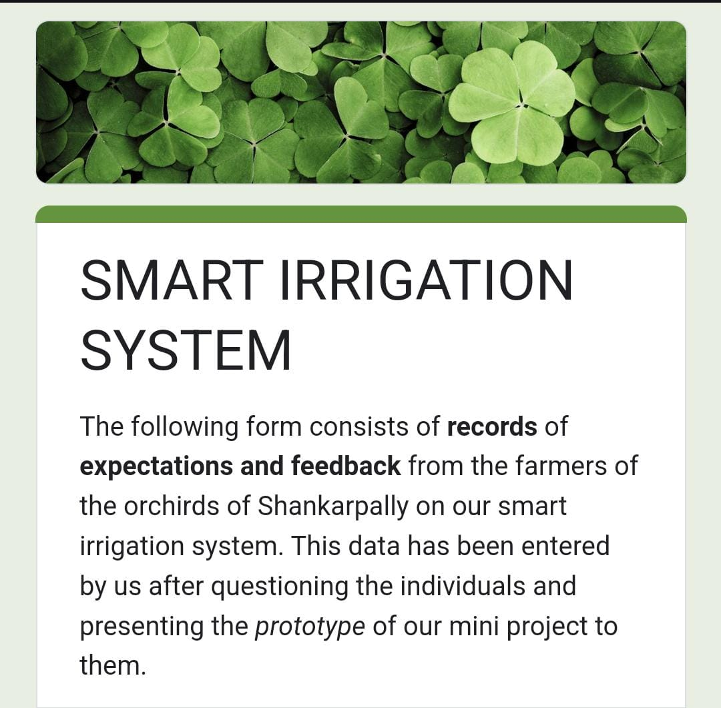
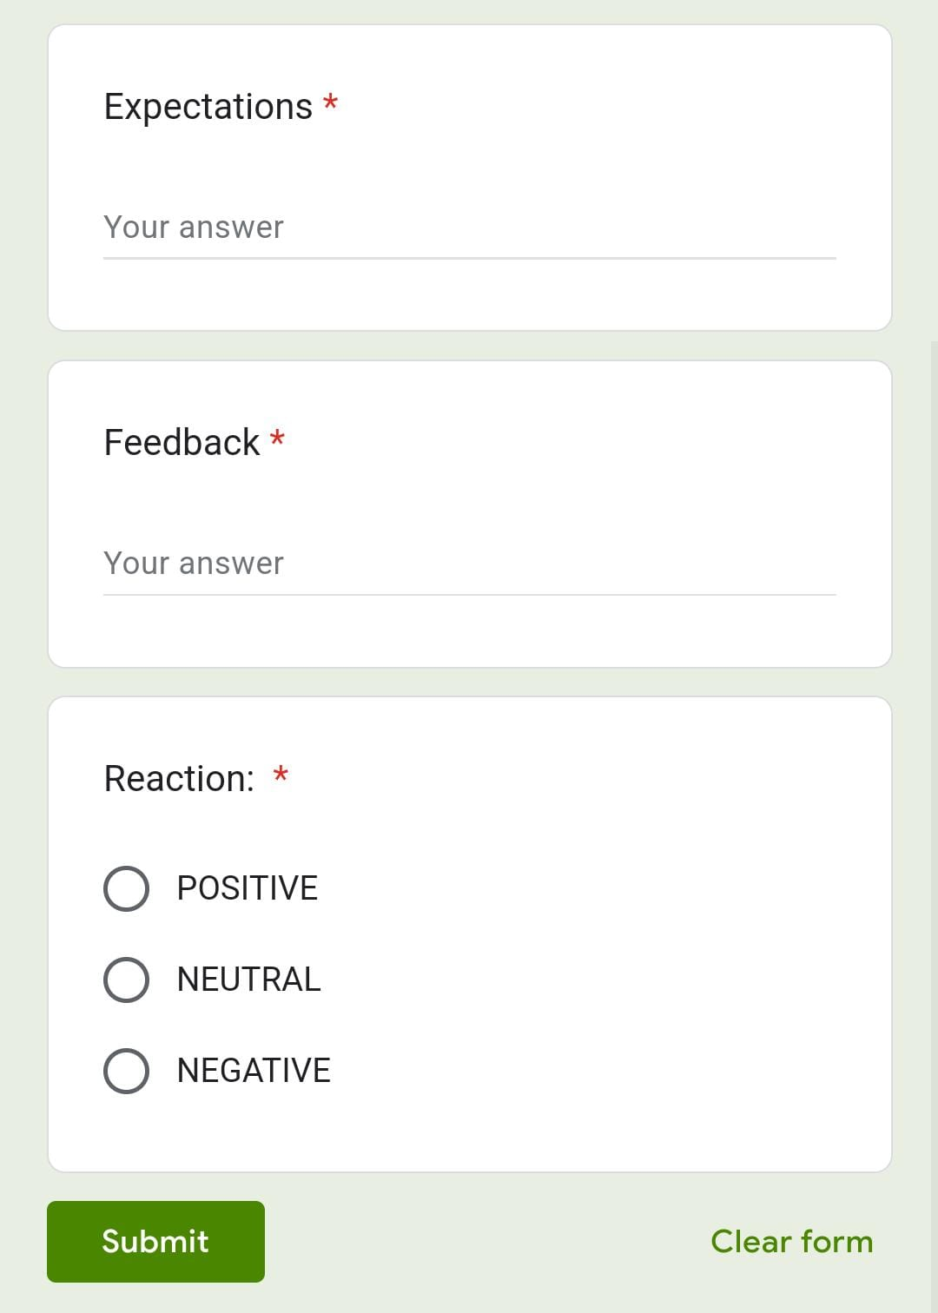
SURVEY

Slide 15
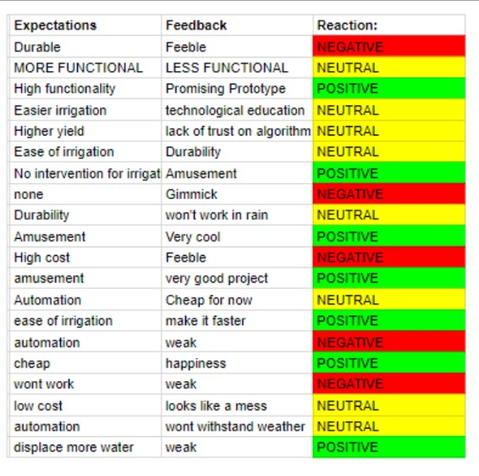
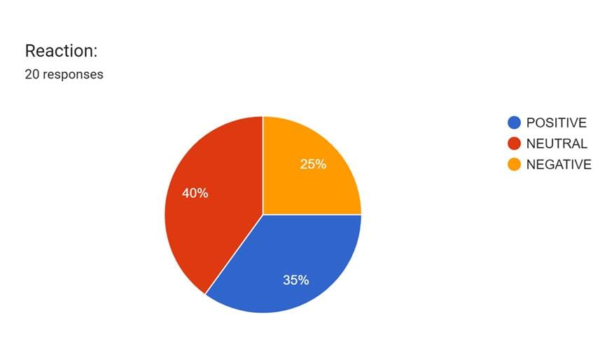

Slide 16
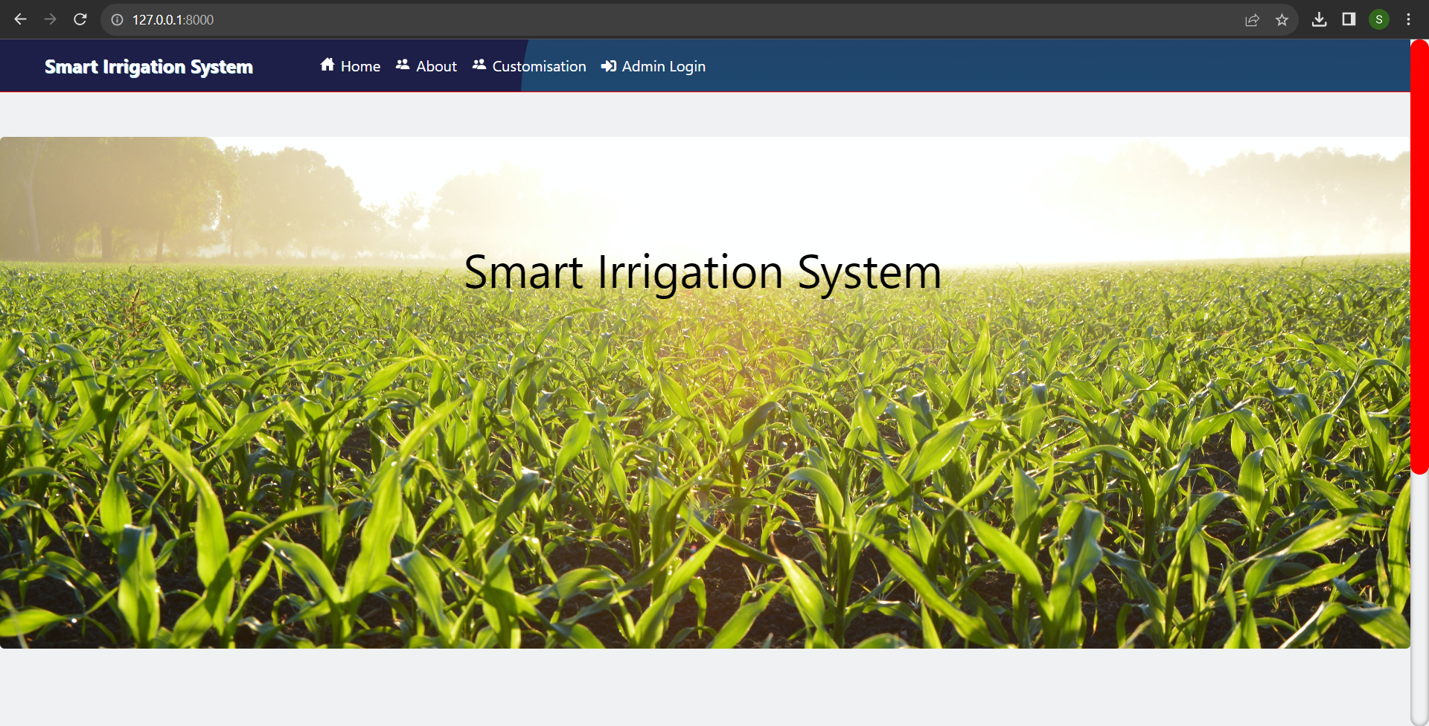
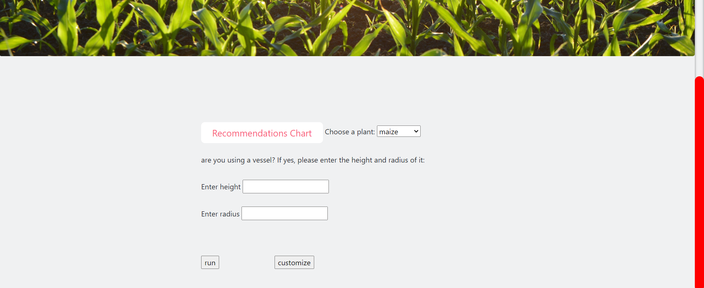
Website - Homepage

Slide 17
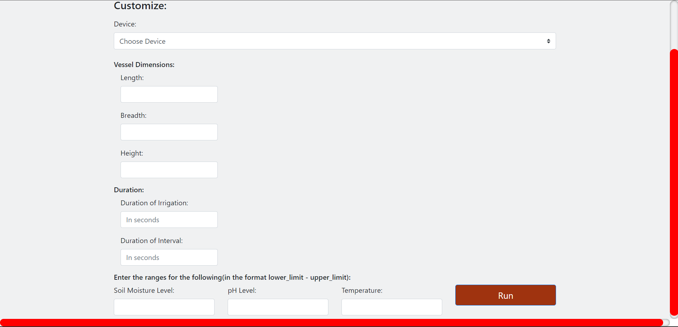
Website - Customisation page

Slide 18
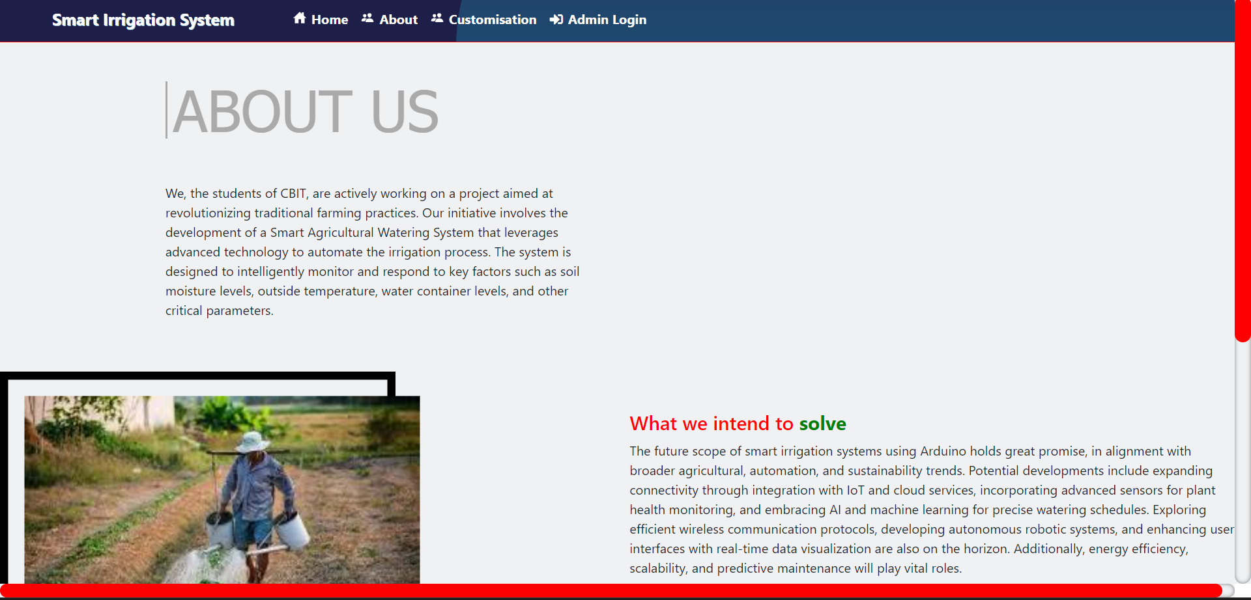
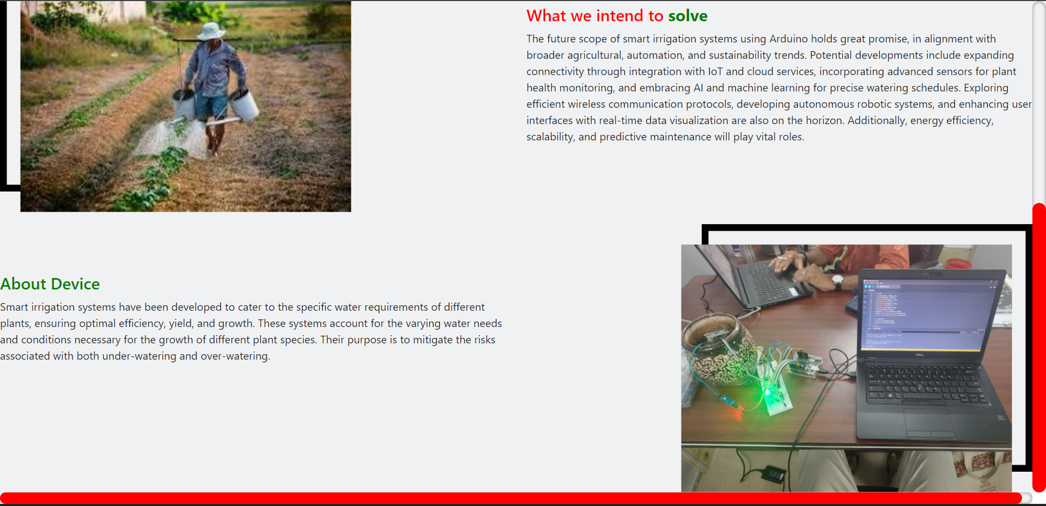
Website - About Us page

Slide 19
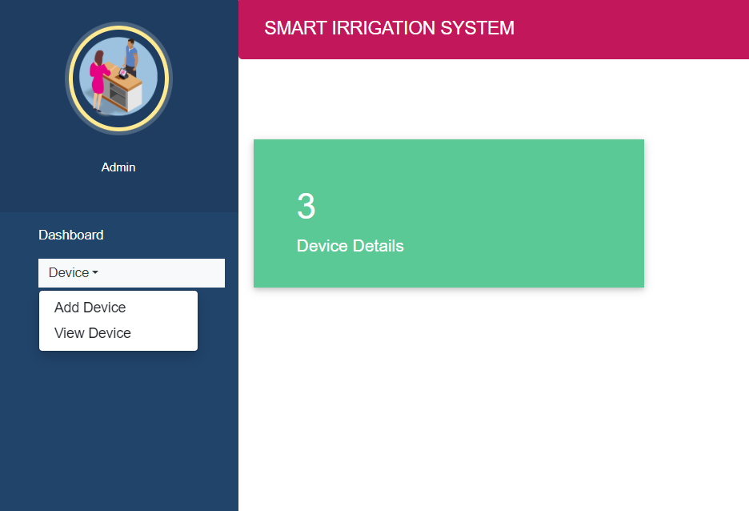
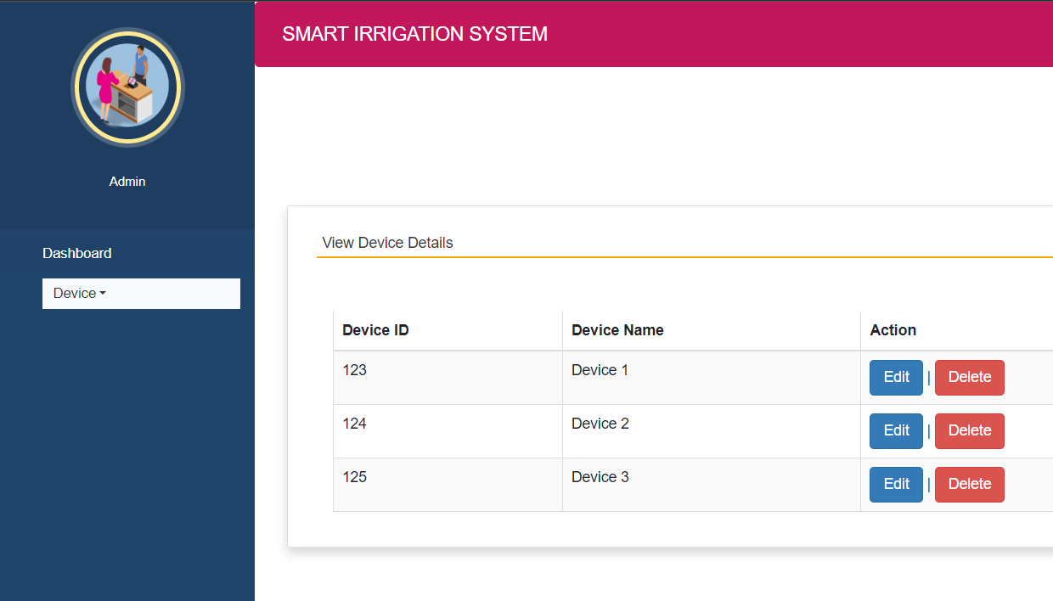
Website - Admin page

Slide 20
Urban Areas
Convenience, water conservation and efficient water usage, optimal growth
Remote control and monitoring, reduced labour, reduced risk of plant stress
Implement fully automated watering schedules that require minimal user intervention, ensuring plants receive the right amount of water without residents' active involvement.

Slide 21
Rural Areas
Smart irrigation systems help reduce water wastage, and capital spent on water. Moreover, they are also a one time investment.
Rural areas have different landscapes, and in each area requirements of crops vary.
It aims to provide efficient, cost-effective, and accessible solutions that empower rural farmers to optimize their operations while addressing the specific challenges of rural agriculture.

Slide 22




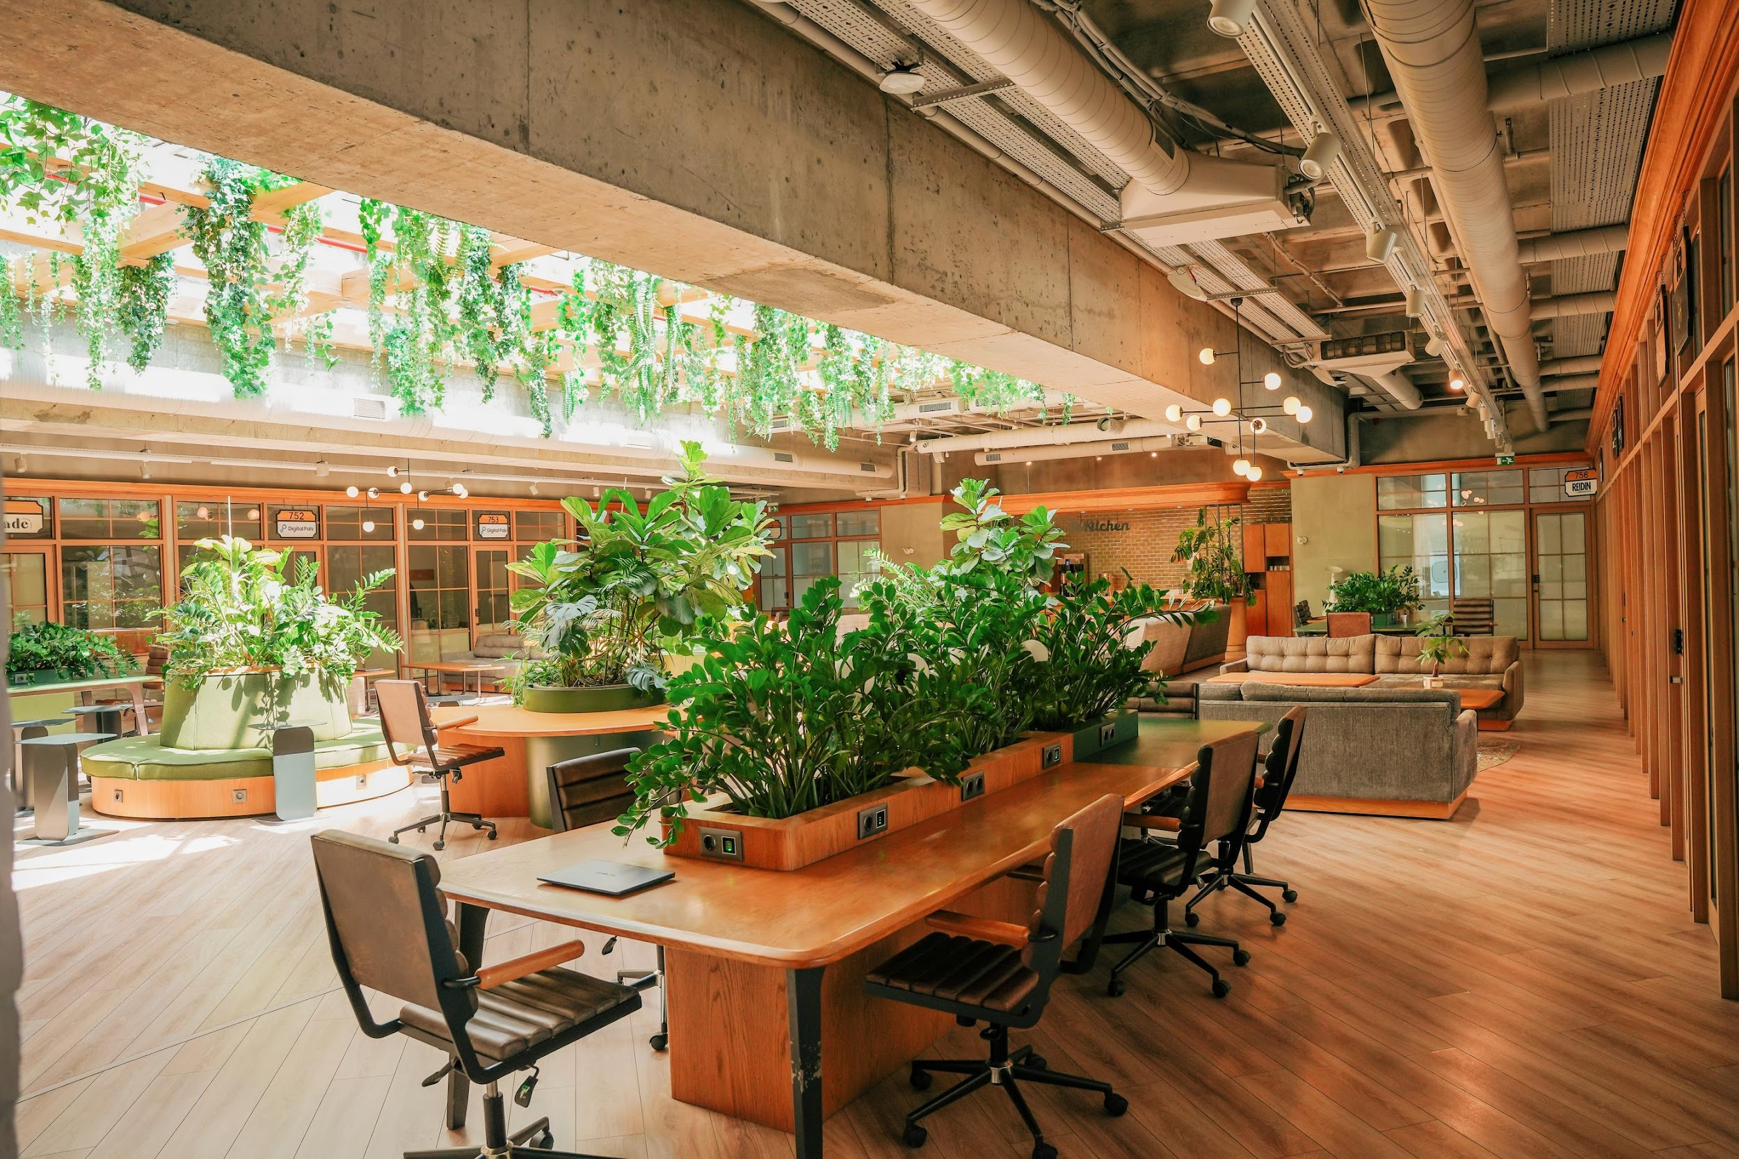
Future scope
Scalability and Precision Farming
Continue to expand the adoption of smart agriculture technologies to cater to larger areas of cultivation.
01
Data-Driven Decision Making
Enhance data collection and analytics capabilities to provide farmers with real-time insights.
02
03
Resource Efficiency
Optimize resource usage, including water, energy, and labor, to reduce operational costs and environmental impact.
04
Safety Measures
Integrate safety features into the farming equipment and systems to protect farmers from exposure to chemicals.

Slide 23
Future scope
Remote Monitoring and Control
The ability to monitor and control irrigation systems remotely via smartphones or web interfaces will become more common. Farmers will have greater flexibility and convenience in managing their irrigation systems from anywhere, improving their overall management of the farm.
05
Affordability and Accessibility
As technology advances, the cost of components for smart irrigation systems is expected to decrease. This will make these systems more affordable and accessible to a broader range of farmers, including small-scale and subsistence farmers.
06

Slide 24
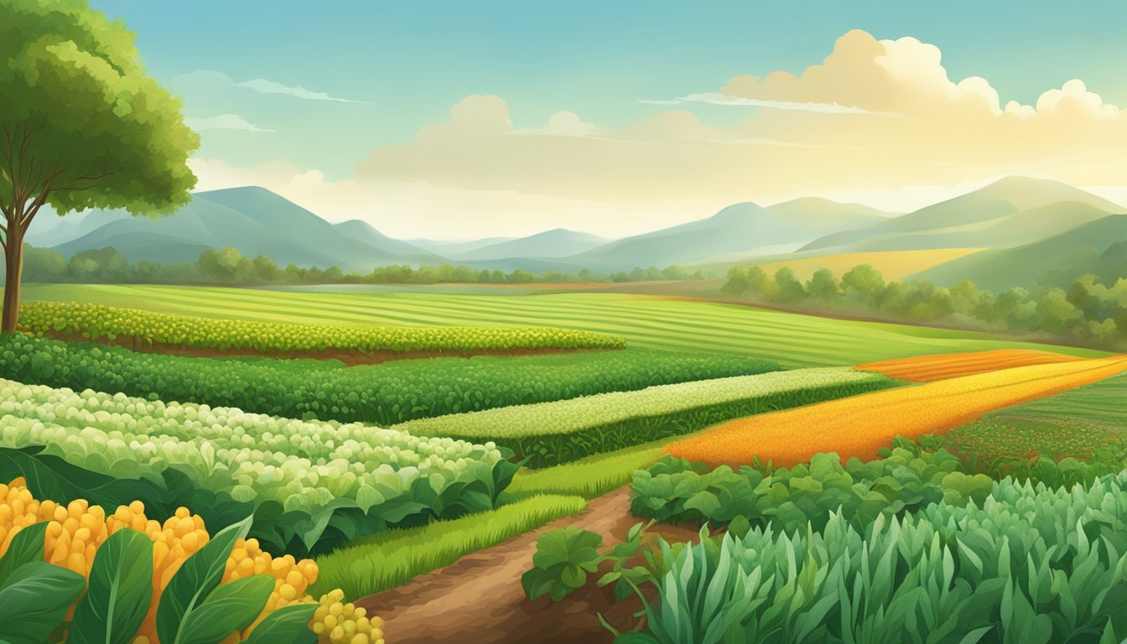
THANKYOU

